Slide 1
Award for Sustainable Pasture Management and Conserving Rangelands 2021
The Award-2021 organized by:
National Federation of Pasture User Groups, NFPUG
Environment and Development Association JASIL,
Ministry of Food, Agriculture and Light Industry, Mongolia,
Central Asia Pastoral Alliance (CAPA),
Central Asia & Mongolia Regional IYRP Support Group (CAM RISG) and
the Mongolian Working Group on “Territories of Life”

Slide 2
Award Winners
Profile of Pastoral Communities
“Bichigt Khad” Pasture User Group
“Sary-Bulak” Pasture User Union
“Aduunchuluun” Pasture User Group
Notes:
How presentation will benefit audience: Adult learners are more interested in a subject if they know how or why it is important to them.
Presenter’s level of expertise in the subject: Briefly state your credentials in this area, or explain why participants should listen to you.

Slide 3
“Bichigt Khad” Pasture User Group
In 2010, 38 herder families who shares same rangeland, boundaries and interest established “Bichigt Khad” PUG
Purpose: To provide flexible management of animal husbandry and migration in accordance with local characteristics, climate change, rangeland carrying capacity, protection from degradation and improvement of rangeland.
Bayan-Ochir B. was elected as a leader
Uvs province Davst soum “Bichigt khad" PUG leader Bayan-Ochir Bayanzul, with his wife Chimed Baatar
Notes:
Lesson descriptions should be brief.

Slide 4
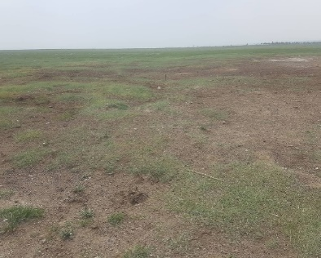
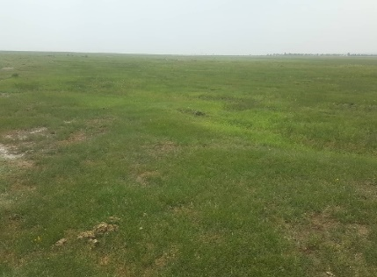
“Bichigt Khad” Pasture User Group (cont.)
He has led 38 households, initiated number of activities to protect rangeland, improve the quality of livestock, adjust the number of livestock to the rangeland carrying capacity, and improve herders' incomes.
In 2016, group established a 15-year rangeland use agreement with the soum governor to use 19,398,000 hectares for the purpose of protecting and rehabilitating rangeland.
Benefit: Increasing the responsibility of herders and ensuring their traditional rights to use and protect their pastures
How to monitor the result?: To identify short-term changes in the implementation result of the rangeland use agreement, photo monitoring surveys are conducted at two plots each year
Figure 1: Before
Figure 2: After
Notes:
Example objectives
At the end of this lesson, you will be able to:
Save files to the team Web server.
Move files to different locations on the team Web server.
Share files on the team Web server.

Slide 5
“Bichigt Khad” Pasture User Group (cont.)
Pastureland Management Activities:
Herders of “Khandgait bag” calculated the pasture risk fund at 100 MNT (0.035 USD) per sheep according to the pasture risk fund regulations “Bichigt Khad” rehabilitated and fixed the a 16 m long and 8 m wide hay storage facility in the bag center with money raised by the PUGs.
Risk fund regulations are being discussed and approved by the Khandgait bagh Citizens' Public Meeting.
From 2019, in order to adjust the number of livestock to the carrying capacity of pastures, herders sign an agreement with the “Meat Market” company every year, organize livestock meat preparation, sell excess livestock from pasture carrying capacity into the market, and support herders' incomes.
Notes:
Example objectives
At the end of this lesson, you will be able to:
Save files to the team Web server.
Move files to different locations on the team Web server.
Share files on the team Web server.

Slide 6
“Bichigt Khad” Pasture User Group (cont.)
Pastureland Management Activities (cont.):
In 2020, he established a herder cooperative called “Yamaat Aarag Uul” and successfully established skin and leather tannery. This is making a valuable contribution to use sheepskins profitably and increase income which was previously discarded by herders.
In addition, 3 million MNT was spent to protect the source of the Teel spring by fencing 72m^2 of land. More than 15,000 livestock from 20-30 households is watered from this spring in summer and autumn.
One of the measures to improve pastures is to spread manure on pastures, which is conducted every year.
Notes:
Example objectives
At the end of this lesson, you will be able to:
Save files to the team Web server.
Move files to different locations on the team Web server.
Share files on the team Web server.

Slide 7
“Sary Bulak” Pasture User Union
7043 community member in total, 50% women, 20% youth
The total area of pastures in the community is 4534 hectares, of which 1219 are summer pastures, 1398 are spring pastures, and 1917 are winter pastures.
Pasture committee’s members - 14 people, 9 of them are women.
Community leader: Ms. Guljan Asanova
Notes:
Lesson descriptions should be brief.

Slide 8
“Sary Bulak” Pasture User Union(cont.)
Pastureland Management Activities:
Effective seasonal rotation of pastures planned and regular mobility of livestock on the territory, change of pasture areas according to the level of degradation, measures to restore the livestock of pedigree animals, conservation and development of breeds, restoration of degraded pastures, improvement of the population's access to water resources, conservation, and growth forest cover, effective interaction with the local population, community mobilization, improvement of the cover of local grazing areas.
Notes:
Example objectives
At the end of this lesson, you will be able to:
Save files to the team Web server.
Move files to different locations on the team Web server.
Share files on the team Web server.

Slide 9
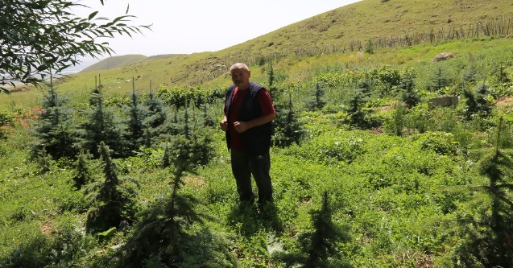
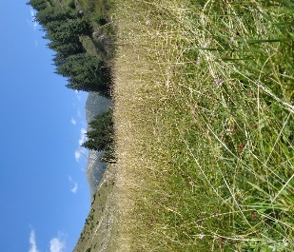
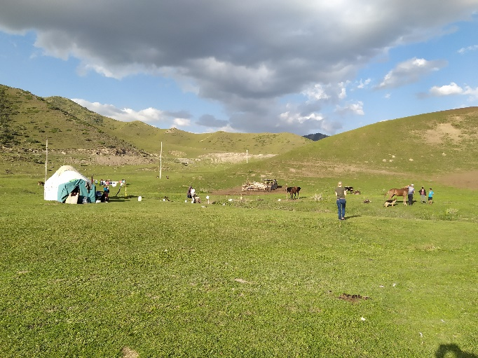
“Sary Bulak” Pasture User Union(cont.)
Pastureland Management Activities (cont.):
The average level of degradation is 38%, however, according to the results of the work of the Pasture Committee, more than half of these lands have been restored.
This was done through the implementation of a strategic plan for effective management, use, and planning of pastures, which was developed by the pasture committee, discussed with the local community, and approved by local MPs.
Result: All pasture areas are used according to the planned system of livestock mobility and are not subject to congestion, trampling, and degradation
To the restoration of forest cover; unique nurseries have been created for the cultivation of pasture trees, including the Tien Shan spruce, where the grown seedlings are subsequently planted on the territory of remote pastures, thereby creating conditions for the natural reproduction of these trees.
Past 10 years more than 80 hectares of land have been planted with seedlings, mainly on the slopes of hills and mountains
Notes:
Example objectives
At the end of this lesson, you will be able to:
Save files to the team Web server.
Move files to different locations on the team Web server.
Share files on the team Web server.

Slide 10
“Sary Bulak” Pasture User Union(cont.)
Pastureland Management Activities (cont.):
This year it is an area of 6,000 hectares, where livestock grazing is prohibited, and to support the owners of livestock, an additional 25 hectares of corn has been sown, from which 70 tons of silage is obtained.
A veterinary pharmacy was built in the village, yurts were purchased for shepherds to facilitate their relocation to remote pastures, and conditions were created for comfortable living on the territory of pastures for the families of shepherds.
Much attention is paid to animal health, regular vaccinations of animals are carried out, preventive measures are taken to increase the potential of community residents to improve the quality of agricultural products.
Notes:
Example objectives
At the end of this lesson, you will be able to:
Save files to the team Web server.
Move files to different locations on the team Web server.
Share files on the team Web server.

Slide 11
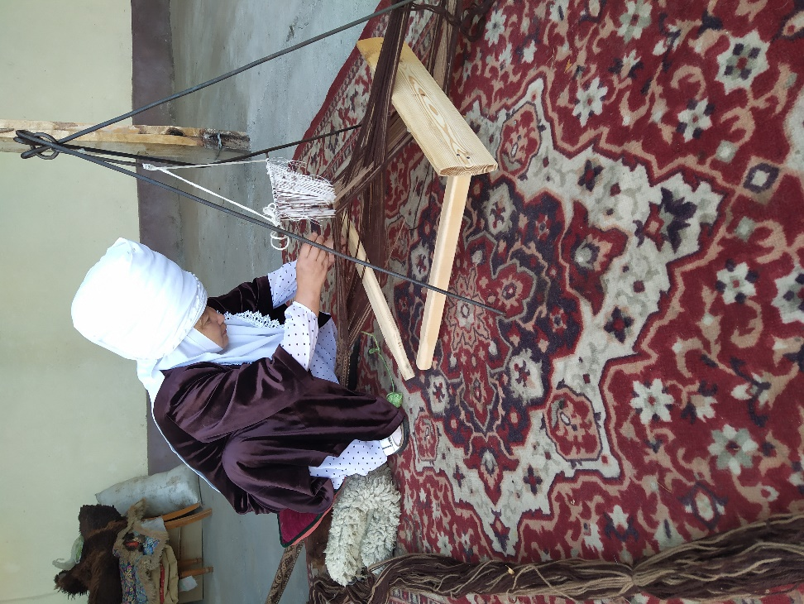
“Sary Bulak” Pasture User Union(cont.)
Activities to increase income:
Women were trained in milk processing at home, the production of 15 types of dairy products, drying, and processing of fruits and vegetables, received special equipment, and began to produce and sell finished products on the local market, the production of felt products, wool processing, production and sale of household items from natural raw materials.
Figure 3: Wool processing and producing the traditional items
Notes:
Example objectives
At the end of this lesson, you will be able to:
Save files to the team Web server.
Move files to different locations on the team Web server.
Share files on the team Web server.

Slide 12
“Aduunchuluun” Pasture User Group
In 2003, 12 herder households in Maikhant Valley established Pastureland and Natural Resources Management Community “Aduunchuluun” and in 2017, renamed as “Aduunchuluun” Pasture User’s Group, PUG.
Community leader: Ms. Solongo J.
Notes:
Lesson descriptions should be brief.

Slide 13
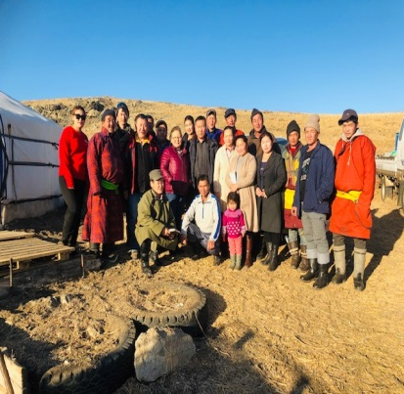
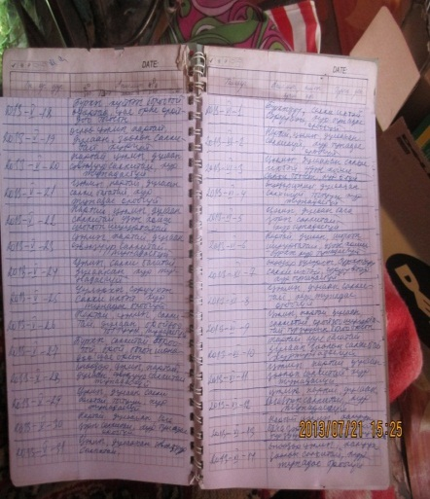
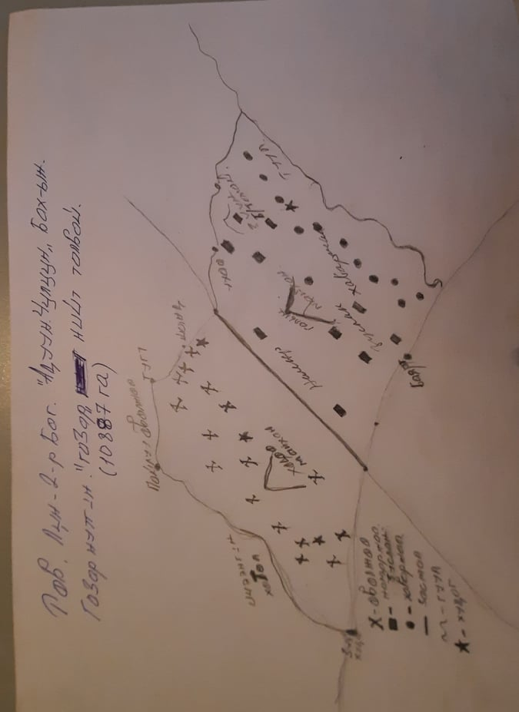
“Aduunchuluun” Pasture User Group(cont.)
The PUG has 10.8 thousand hectares of pastureland and 13.2 thousand sheep
Pastureland Management Activities:
Herders of “Khandgait bag” calculated the pasture risk fund at 100 MNT (0.035 USD) per sheep according to the pasture risk fund regulations “Bichigt Khad” rehabilitated and fixed the a 16 m long and 8 m wide hay storage facility in the bag center with money raised by the PUGs.
Risk fund regulations are being discussed and approved by the Khandgait bagh Citizens' Public Meeting.
From 2019, in order to adjust the number of livestock to the carrying capacity of pastures, herders sign an agreement with the “Meat Market” company every year, organize livestock meat preparation, sell excess livestock from pasture carrying capacity into the market, and support herders' incomes.
Figure 4-6: Community mapping;
WFD notebook by Ms.Solongo; Community members
Notes:
Example objectives
At the end of this lesson, you will be able to:
Save files to the team Web server.
Move files to different locations on the team Web server.
Share files on the team Web server.

Slide 14
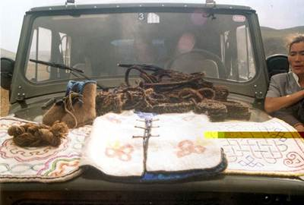
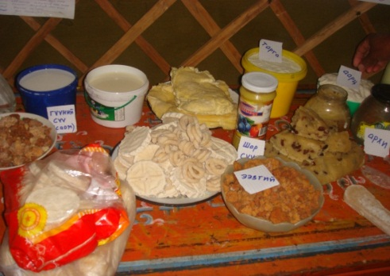
“Aduunchuluun” Pasture User Group(cont.)
Activities to increase income:
From 2019, 1.5 tons of cashmere will be produced and supplied to the Wool and Cashmere Association
Marketing milk, meat, and other daily food products for the consumers of the soum and the Ulaanbaatar city.
In collaboration with the JASIL, the specific location Weather Forecast Data, WFD, has been regularly delivering to herders and using it in Pasture management and livelihood improvement.
Result: Between 2011-2020 livestock loss was reduced by 32-69%
Figure 7-8: Community goods; Food items of the community
Notes:
Example objectives
At the end of this lesson, you will be able to:
Save files to the team Web server.
Move files to different locations on the team Web server.
Share files on the team Web server.

